Slide 1
O~~~~~~~~~~JEOPARDY!~~~~~~~~~O
Guess the Term
Output
Find the Value
Code up
Object Oriented
$100
$100
$100
$100
$100
$200
$200
$200
$200
$200
$300
$300
$300
$300
$300
$400
$400
$400
$400
$400
$500
$500
$500
$500
$500
Final Jeopary!!!

Slide 2
GUESS THE TERM - $100
int num1 = 1;
double num2 = 1.5;
In the code above, what are “int” and “double” called?
Datatypes

Slide 3
GUESS THE TERM - $200
javac Test.java
What action is being taken in the code above?
Compiling

Slide 4
GUESS THE TERM - $300
A relationship between two classes in which one class ( the subclass) inherits all of the properties and capabilities of another ( the superclass)
Inheritance

Slide 5
GUESS THE TERM - $400
for(int i = 0; i < 10; i++){
  for(int k = 0; k < 10; k++){
  System.out.println(“Hello”);
  }
}
The example shows a _____ for loop
Nested

Slide 6
GUESS THE TERM - $500
The class Dog is a subclass of Pet then,
Public class Dog _____ Pet{
}
extends

Slide 7
OUTPUT - $100
System.out.print(“hey”);
System.out.println(“there”);
System.out.println(“friend”);
heythere
friend

Slide 8
OUTPUT - $200
Int [] array = {1, 7, 4, 67, 20};
System.out.println(array.length);
5

Slide 9
OUTPUT - $300
int a = 3;
int b = 5;
a++;
System.out.println(a*b);
20

Slide 10
OUTPUT - $400
int a = 8;
int b = 3;
int c = 15;
System.out.println(2.0*(a/b*(c+a)));
92.0

Slide 11
OUTPUT - $500
String a = word;
boolean b = false;
b = (a.indexOf(“w”))<(a.indexOf(“r”));
System.out.println((b||false)&&true);
true

Slide 12
FIND THE VALUE - $100
1+8%3+6
9

Slide 13
FIND THE VALUE - $200
false||(true&&false)
false

Slide 14
FIND THE VALUE - $300
Boolean b = true;
What is the value of !b||true?
true

Slide 15
FIND THE VALUE - $400
20/(4+1)*10
40

Slide 16
FIND THE VALUE - $500
int a = 0;
for(int i = 0; i < 10; i++){
  a+=i;
}
45

Slide 17
4 - $100
Type question to appear here
Type answer to appear with a mouse-click here

Slide 18
4 - $200
Type question to appear here
Type answer to appear with a mouse-click here

Slide 19
4 - $300
Type question to appear here
Type answer to appear with a mouse-click here

Slide 20
4 - $400
Type question to appear here
Type answer to appear with a mouse-click here

Slide 21
4 - $500
Type question to appear here
Type answer to appear with a mouse-click here

Slide 22
5 - $100
Type question to appear here
Type answer to appear with a mouse-click here

Slide 23
5 - $200
Type question to appear here
Type answer to appear with a mouse-click here

Slide 24
5 - $300
Type question to appear here
Type answer to appear with a mouse-click here

Slide 25
5 - $400
Type question to appear here
Type answer to appear with a mouse-click here

Slide 26
5 - $500
Type question to appear here
Type answer to appear with a mouse-click here

Slide 27
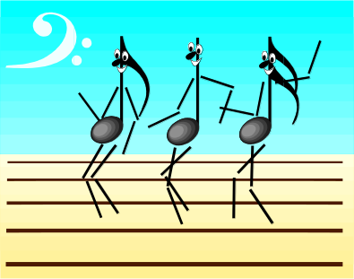
FINAL JEOPARDY
Type question to appear here
Type answer to appear with a mouse-click here

